Slide 1



Noida Institute of Engineering and Technology, Greater Noida
Innovation, Quality & Leadership
Unit: IV
Design Thinking-II
Ms. Barkha Bhardwaj
Assistant Professor (CSE-AI)
NIET, Gr. Noida
B Tech V Semester

Slide 2
Index
S. No. | Content
1. | Name of Subject with code, Course and Subject Teacher
2. | Brief Introduction of Faculty member with Photograph
3. | Evaluation Scheme
4. | Syllabus
5. | Branch wise Application
6. | Course Objective(s)
7. | Course Outcome(s)
8. | Program Outcomes (PSOs)
9. | Cos and POs Mapping

Slide 3

Index
S. No. | Content
10. | Program Specific Outcomes (PSOs)
11. | Cos and PSOs Mapping
12. | Program Educational Objectives (PEOs)
13. | Result Analysis
14. | End Semester Question paper Templates
15. | Prequisite/Recap
16. | Brief Indtroduction about the Subject with Videos
17. | Unit Contents
18. | Unit Objectives
19. | Topic Objectives/Topic Outcome

Slide 4
Index
S. No. | Content
20. | Lecture related to topic
21. | Daily Quiz
22. | Weekly Assignment
23. | Topic Links
24. | MCQs
25. | Glossary Questions
26. | Old question papers
27. | Expected Questions
28. | Recap of unit

Slide 5
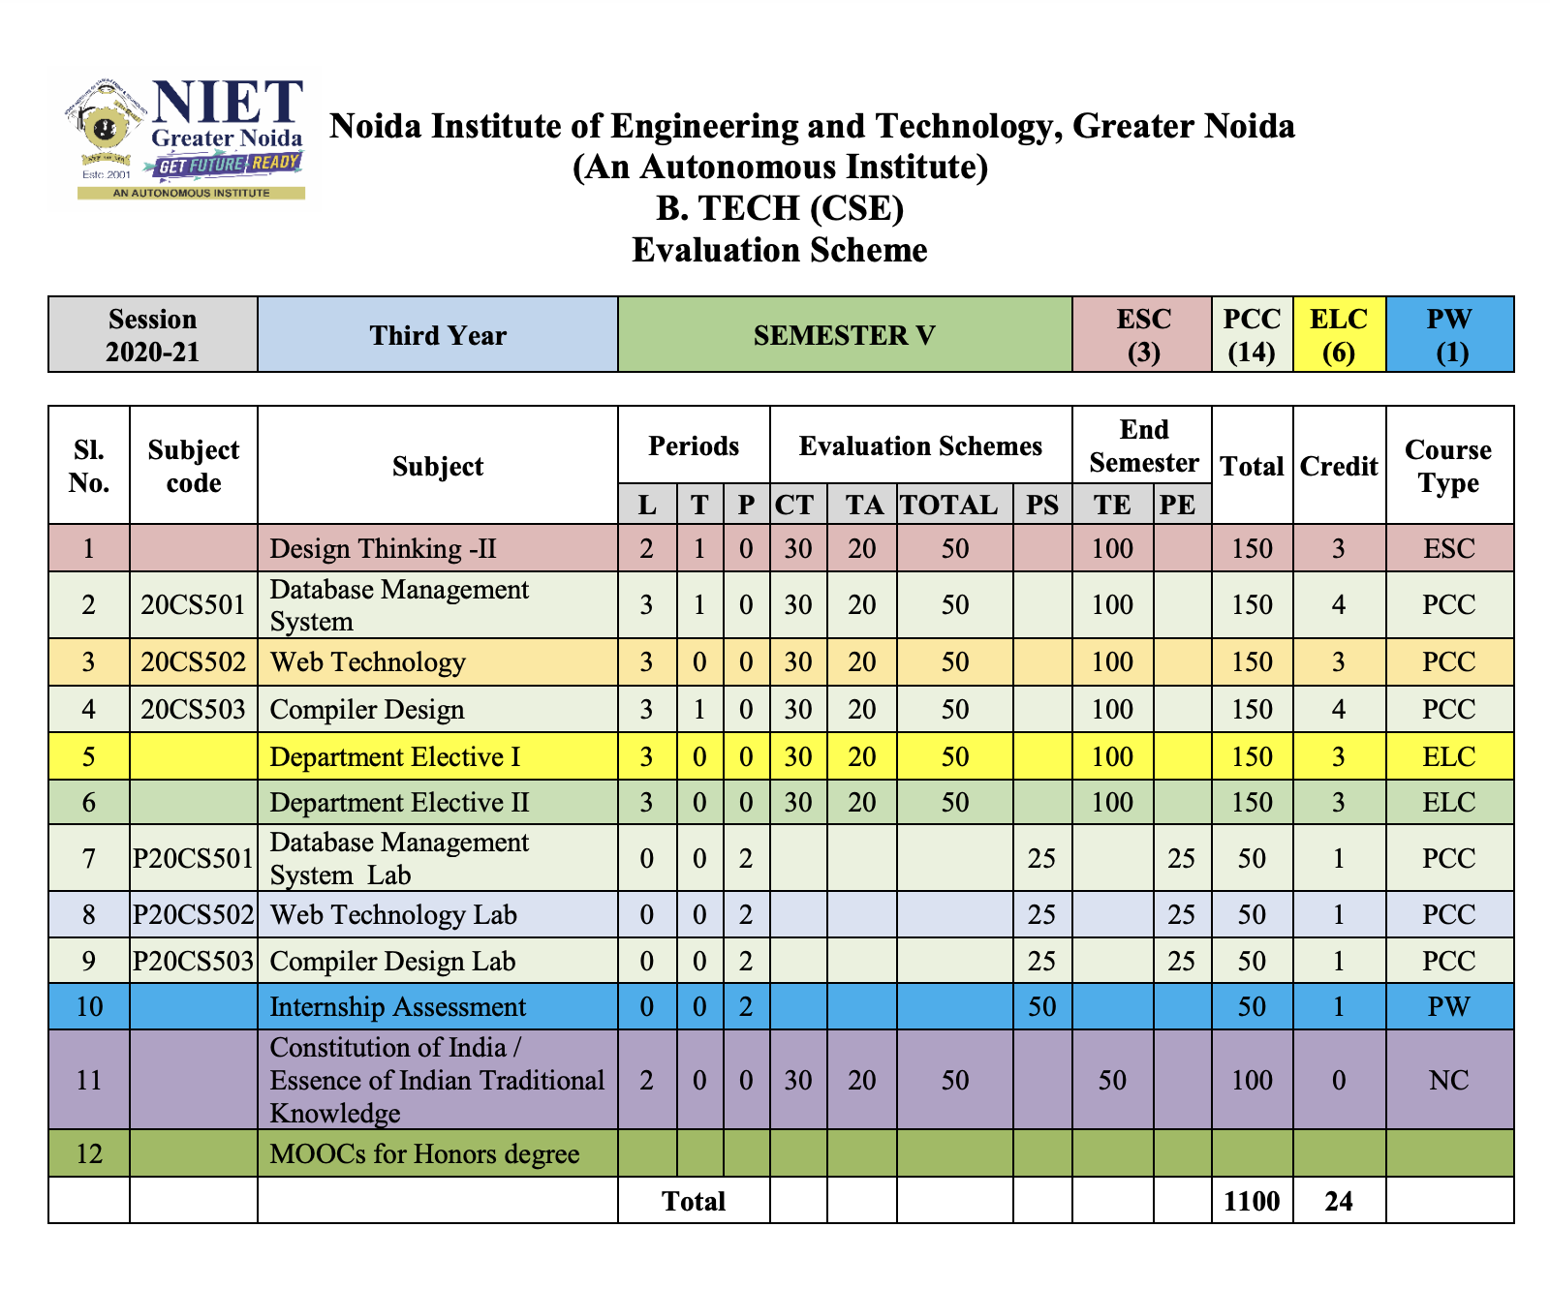
Evaluation Scheme

Slide 6
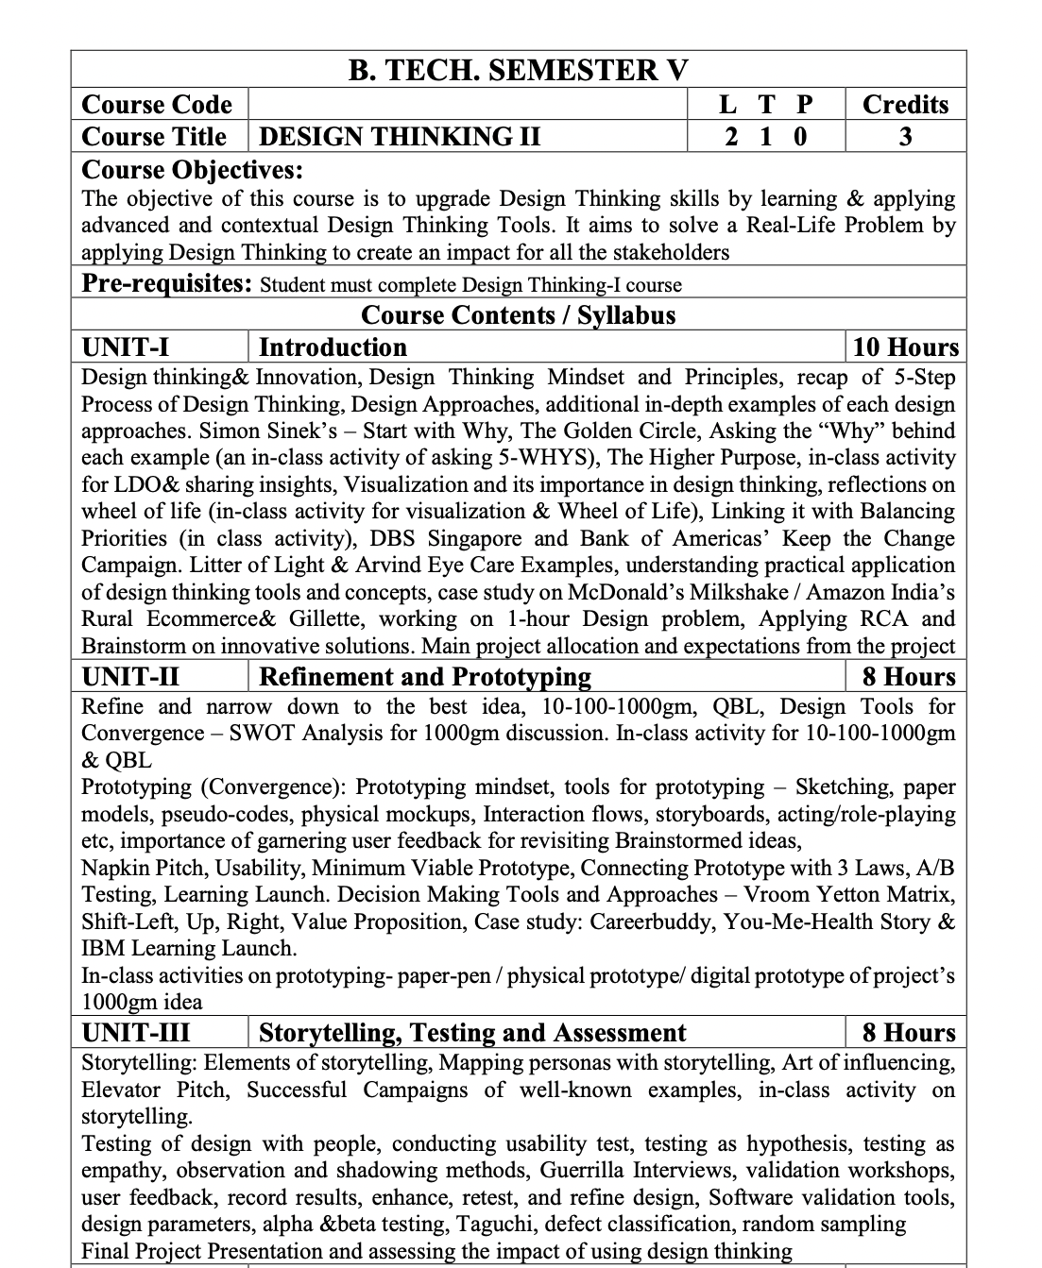
Syllabus

Slide 7

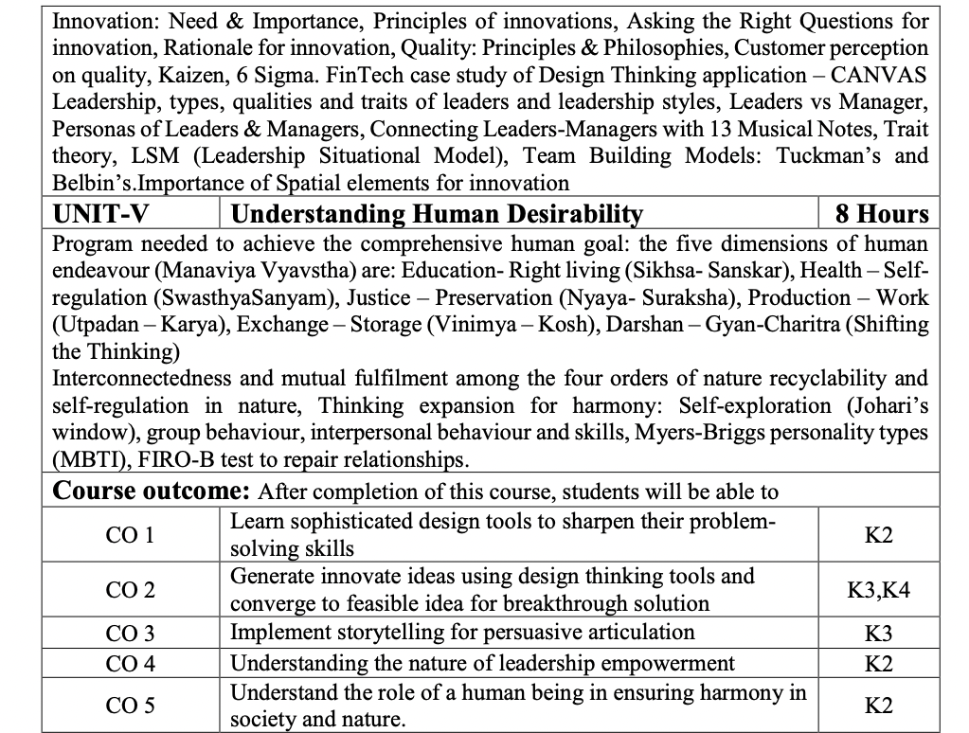
Syllabus

Slide 8
Branch Wise Application
Leadership development
Creating innovative mindset
Ensuring quality in offering or solutions

Slide 9
Course Objectives
To upgrade Design Thinking skills by learning & applying advanced and contextual Design Thinking Tools.
Aims to solve a Real-Life Problem by applying Design Thinking to create an impact for all the stakeholders .

Slide 10
Course Outcomes
After completion of this course, students will be able to-
CO1: Learn sophisticated design tools to sharpen their problem- solving skills.
CO2: Generate innovate ideas using design thinking tools and converge to feasible idea for breakthrough solution.
CO3: Implement storytelling for persuasive articulation
CO4: Understanding the nature of leadership empowerment
CO5: Understand the role of a human being in ensuring harmony in society and nature.

Slide 11
Program Outcomes (POs)
PO1 : Engineering Knowledge
PO2 : Problem Analysis
PO3 : Design/Development of solutions
PO4 : Conduct Investigations of complex problems
PO5 : Modern tool usage
PO6 : The engineer and society

Slide 12
Program Outcomes (POs)
PO7 : Environment and sustainability
PO8 : Ethics
PO9 : Individual and teamwork
PO10 : Communication
PO11 : Project management and finance
PO12 : Life-long learning

Slide 13

COs & POs Mapping
CO.K | PO1 | PO2 | PO3 | PO4 | PO5 | PO6 | PO7 | PO8 | PO9 | PO10 | PO11 | PO12
CO1 | 2 | 2 | 2 | 3 | 3 | 2 | 2 | 3 | 2 | 2 | 2 | 3
CO2 | 3 | 2 | 3 | 2 | 3 | 3 | 3 | 3 | 2 | 2 | 3 | 3
CO3 | 3 | 2 | 3 | 2 | 3 | 2 | 3 | 3 | 2 | 3 | 2 | 2
CO4 | 3 | 2 | 3 | 2 | 3 | 3 | 2 | 2 | 3 | 2 | 2 | 3
CO5 | 3 | 2 | 3 | 3 | 3 | 2 | 3 | 2 | 2 | 2 | 3 | 3
AVG | 2.8 | 2.0 | 2.8 | 2.4 | 3.0 | 2.4 | 2.6 | 2.6 | 2.2 | 2.2 | 2.4 | 2.8
*1=Low, *2=Medium, *3=High

Slide 14
Program Specific Outcome
At the end of the program, the student will be able to:
Apply technical and business knowledge to solve complex problems and face current business challenges.
Explore modern tools and technologies and apply the knowledge to design and develop solutions for betterment of the society.
Work innovatively and communicate effectively with professionals worldwide and pursue lifelong learning to add value to society and environment.

Slide 15
COs & PSOs Mapping
CO.K | PSO1 | PSO2 | PSO3
CO1 | 3 | 2 | 2
CO2 | 3 | 3 | 2
CO3 | 3 | 3 | 3
CO4 | 3 | 3 | 2
CO5 | 3 | 3 | 2

Slide 16
Program Educational Objectives
Program Educational Objectives (PEOs) | PEOs Description
PEO 1 | To have an excellent scientific and engineering breadth so as to comprehend, analyze, design and provide sustainable solutions for real-life problems using state-of-the-art technologies.
PEO 2 | To have a successful career in industries, to pursue higher studies or to support entrepreneurial endeavors and to face the global challenges.
PEO 3 | To have an effective communication skills, professional attitude, ethical values and a desire to learn specific knowledge in emerging trends, technologies for research, innovation and product development and contribution to society.
PEO 4 | To have life-long learning for up-skilling and re-skilling for successful professional career as engineer, scientist, entrepreneur and bureaucrat for betterment of society.

Slide 17
Result Analysis
Semester: V Session: 2022-23
Subject Name & Code | Total Number of Students | Pass (%) | 40>65 (%) | 65>75 (%) | 75>90 (%) | 90 & Above (%) | Backlog | Average Marks
Not Applicable

Slide 18
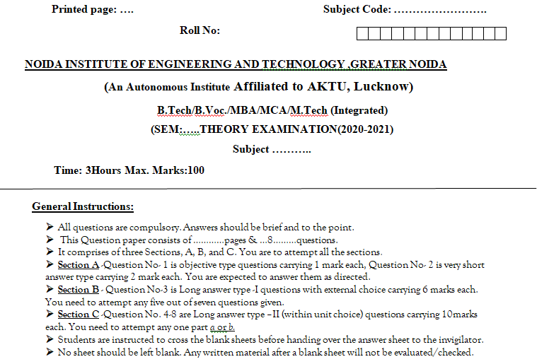
End Semester Question Paper Template

Slide 19

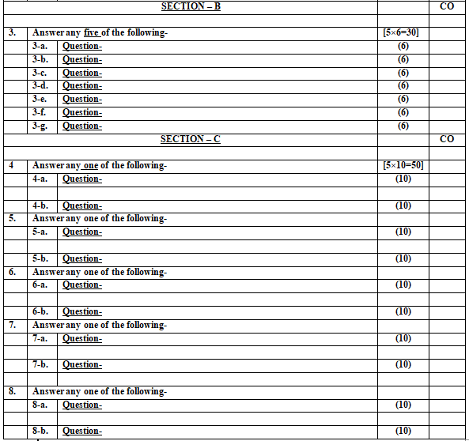
End Semester Question Paper Template

Slide 20
Prerequisites / Recap
Design Thinking Basics
Empathy
Value & ethics
Ideation
Critical thinking

Slide 21
Brief Introduction of Subject: Video
https://www.youtube.com/watch?v=6-NRiom8K9Y
https://www.youtube.com/watch?v=ldYzbV0NDp8
https://www.youtube.com/watch?v=_KK958OkD6g

Slide 22
Unit Content
Innovation: Need & Importance, Principles of innovations, Asking the Right Questions for innovation, Rationale for innovation,
Quality: Principles & Philosophies, Customer perception on quality, Kaizen, 6 Sigma. FinTech case study of Design Thinking application-CANVAS
Leadership, types, qualities and traits of leaders and leadership styles, Leaders vs Manager, Personas of Leaders & Managers, Connecting Leaders-Managers with 13 Musical Notes, Trait theory, LSM (Leadership Situational Model), Team Building Models: Tuckman's and Belbin's. Importance of Spatial elements for innovation

Slide 23
Unit Objectives
To identify the need of innovation and inculcating innovation in practice for results.
To understand the concept of quality with its application in projects for meeting customer requirements.
To develop leadership qualities and skills in order to give direction and motivating the people across organization.
To learn and develop team building skills to ensure timely and efficient delivery.

Slide 24
COs-POs Mapping
CO.K | PO1 | PO2 | PO3 | PO4 | PO5 | PO6 | PO7 | PO8 | PO9 | PO10 | PO11 | PO12
CO1 | 2 | 2 | 2 | 3 | 3 | 2 | 2 | 3 | 2 | 2 | 2 | 3
CO2 | 3 | 2 | 3 | 2 | 3 | 3 | 3 | 3 | 2 | 2 | 3 | 3
CO3 | 3 | 2 | 3 | 2 | 3 | 2 | 3 | 3 | 2 | 3 | 2 | 2
CO4 | 3 | 2 | 3 | 2 | 3 | 3 | 2 | 2 | 3 | 2 | 2 | 3
CO5 | 3 | 2 | 3 | 3 | 3 | 2 | 3 | 2 | 2 | 2 | 3 | 3
AVG | 2.8 | 2.0 | 2.8 | 2.4 | 3.0 | 2.4 | 2.6 | 2.6 | 2.2 | 2.2 | 2.4 | 2.8
*1=Low, *2=Medium, *3=High

Slide 25
Prerequisites and Topic wise Recap
Design Thinking Basics
Empathy
Value & ethics
Ideation
Critical thinking

Slide 26
Topic & CO Mapping
S No | Topic | CO | Level
1 | Innovation: Need & Importance, Principles of innovations | CO 4 | 2
2 | Quality: Principles & Philosophies | CO 4 | 2
3 | Customer perception on quality, Kaizen, 6 Sigma | CO 4 | 2
4 | Leadership, types, qualities and traits of leaders and leadership styles, Leaders vs Manager | CO 4 | 3
5 | Personas of Leaders & Managers, Connecting Leaders-Managers with 13 Musical Notes | CO 4 | 2
6 | LSM (Leadership Situational Model), Team Building Models: Tuckman's and Belbin's. Importance of Spatial elements for innovation | CO 4 | 3

Slide 27
Noida Institute of Engineering and Technology, Greater Noida
(Unit –IV) Topic 1
Innovation: Need & Importance
Principles of innovations

Slide 28
Topic & CO Mapping
Topic | CO | Level
Innovation: Need & Importance, Principles of innovations | CO 4 | 2

Slide 29
Topic Objectives And Outcomes
Topic Objectives:
To Understand the need and importance of innovation.
To Understand and learn principles of innovation
Topic Outcomes:
Ability to develop innovation acumen
Application of innovation principles in developing products

Slide 30
Recap
Storytelling
Testing
Assessment

Slide 31
Innovation
Practical implementation of ideas that result in the introduction of new goods or services or improvement in offering goods or services.
Turning a new concept into commercial success or widespread use
Notes:
Process of realizing new products, processes, propositions, or business models to create added value for customers and/or employees

Slide 32
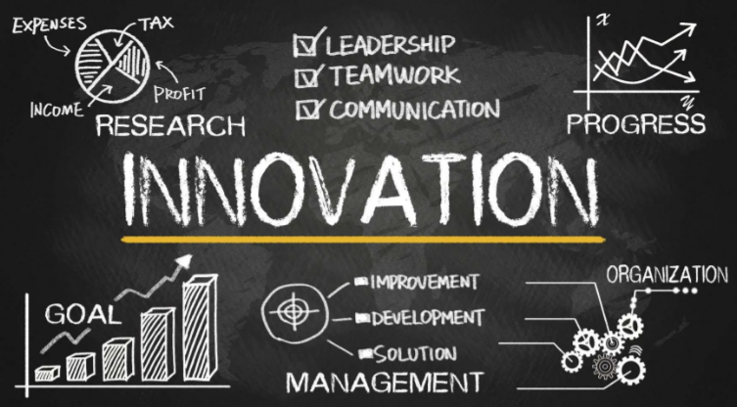
Innovation

Slide 33
Need of Innovation
Grow in Leaps and Bounds
Stand Out from Competitors
Meet Customer Needs
Attract the Best Talent

Slide 34
Importance of Innovation
Creative Development
You can achieve growth by learning how to be creative.
Continuous Improvement
Innovation gives organizational sustainability when you are making continual improvements and repackaging and re-branding.
Responding to Competition and Trends
Innovation can help you to see what exists now in opportunities or which ones will likely pop up in the near future.
Having a Unique Selling Point
consumers will see innovation as something which adds value to products or a company

Slide 35
Importance of Innovation
Keeps Organizations Relevant
Boosts Creativity & Confidence
Necessary For Sustainability
Workplace Improvement
Gives Competitive Advantage
Impacts Economic Growth

Slide 36
Eight Essentials of Innovation
Aspire
President John F. Kennedy’s bold aspiration, in 1962, to “go to the moon in this decade” motivated a nation to unprecedented levels of innovation. A far-reaching vision can be a compelling catalyst, provided it’s realistic enough to stimulate action today.
Lantmännen, a big Nordic agricultural cooperative (4+2% to 14% growth)
Choose
Fresh, creative insights are invaluable, but in our experience many companies run into difficulty less from a scarcity of new ideas than from the struggle to determine which ideas to support and scale.
RELX Group: preliminary budget of around $200,000 to run new experiment in customer segment each year

Slide 37
Eight Essentials of Innovation
Discover
Innovation also requires actionable and differentiated insights—the kind that excite customers and bring new categories and markets into being
3 areas: a valuable problem to solve, a technology that enables a solution, and a business model that generates money from it.
Evolve
As smartphones and mobile apps threaten to upend oldline industries, business-model innovation, established companies must reinvent their businesses before technology-driven upstarts do
Amazon does a particularly strong job extending itself into new business models by addressing the emerging needs of its customers and suppliers.

Slide 38
Eight Essentials of Innovation
Accelerate
A surprising number of impressive innovations from companies were actually the fruit of their mavericks (single person decision making process), who succeeded in bypassing by their early-approval processes
At many companies, marketing’s role is to champion the interests of end users to help development teams evolve products.
Scale
Considering the appropriate magnitude and reach of a given idea is important to ensuring that the right resources and risks are involved in pursuing it
TomTom launched its first touch-screen navigational device 5-12 million

Slide 39
Eight Essentials of Innovation
Extend
Smart collaboration with external partners, though, goes beyond merely sourcing new ideas and insights; it can involve sharing costs and finding faster routes to market.
the components of Apple’s first iPod were developed almost entirely outside the company
Mobilize (to organize people or things to do something)
Find ways to embed innovation into the fibers of their culture, from the core to the periphery.
Discovery Group, for example, is upending the medical and life-insurance industries

Slide 40
Eight Essentials of Innovation
The Eight Essentials of Innovation are:
Aspire: Set high goals and commit to achieving them.
Choose: Select the best opportunities and focus resources on them.
Discover: Look for new ideas by exploring different sources and perspectives.
Evolve: Adapt and refine ideas through testing and feedback.
Accelerate: Speed up the development and implementation of ideas.
Scale: Expand successful innovations effectively.
Extend: Collaborate with external partners for broader reach.
Mobilize: Build a culture and structure that supports continuous innovation.

Slide 41
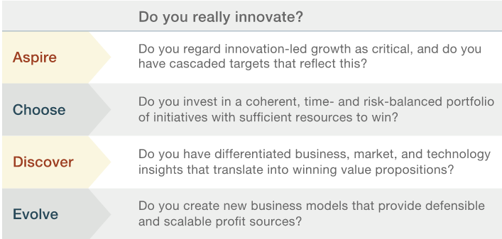
Eight Essentials of Innovation

Slide 42

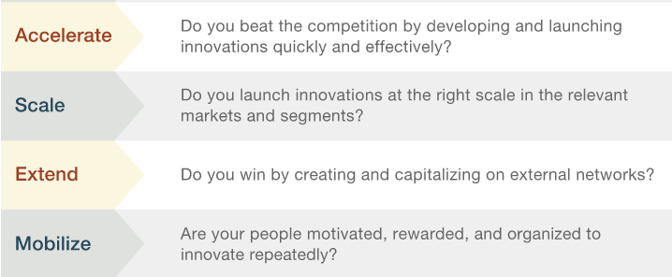
Eight Essentials of Innovation
6/25/2022
Harsh Awasthi (DT-II) Unit-4
42

Slide 43
Types of Innovation
Product Innovation
This focuses on creating a new product, service, or product feature.
Examples the pivoting head of Gillette razor blades.
(Shirts Making use of phase-change materials (PCMs), which takes heat away from you when you're feeling warm, and gives it back to you when you're feeling cold.)
2. Process innovation
This refers to changes made to make a process more efficient. For example, assembly lines were a breakthrough in manufacturing.
(drone for delivery of goods, driver less cars)
3. Business Model innovation
This is when you transform business operations.
Ride-sharing platforms, such as Uber, are an example of this. They took the taxi and car service companies’ business model and altered it to a peer-to-peer, digitized model.
(selling books by weight)

Slide 44
Levels of Innovation
1. Incremental innovation (Mobile Phone)
Small changes that increase the efficiency of your current business model.
2. Expansive innovation (Work from home culture)
Change that results from exploring new ideas. Its purpose is to sustain and grow the company in the long term.
3. Disruptive innovation (Reliance Jio)
Creates a completely new business model, offering a novel value proposition.

Slide 45
Principles of Innovation
Analyze the sources of innovation for opportunities
Determine customer needs, wants and expectations
Innovation should be simple and focused
Innovation should start small
Innovation should aim at leadership
Peter F Druker
Innovation and Entrepreneurship: Practice and Principles.
Harper & Row, Publishers, Inc. 1985.

Slide 46
Summary
Innovation
Types of innovation
Need of innovation
Importance of innovation
Principles of innovation

Slide 47
Daily Quiz
Q1. Describe the innovation.
Q2. Discuss the need of innovation.
Q3. Enumerate the importance of innovation in business.
Q4. Discuss the principles of innovation.
Q5. Describe the types innovation.

Slide 48
Noida Institute of Engineering and Technology, Greater Noida
(Unit –IV) Topic 2
Quality: Principles & Philosophies

Slide 49
Topic & CO Mapping
Topic | CO | Level
Quality: Principles & Philosophies | CO 4 | 2

Slide 50
Topic Objectives And Outcomes
Topic Objectives:
To understand the concept of quality
To understand the principles & philosophies of quality.
Topic Outcomes:
Ability to apply quality concepts in creating products

Slide 51
Recap
Innovation
Types of innovation
Need of innovation
Importance of innovation
Principles of innovation

Slide 52
Quality
The philosophy of quality has traditionally focused upon the development and implementation of a corporate wide culture that emphasizes a customer focus, continuous improvement, employee empowerment, and data-driven decision making.

Slide 53
Quality
Fitness for use in terms of design, conformance, availability, safety, and field use. His approach is based customer, top-down management and technical methods.
Dr Joseph Juran

Slide 54
Quality: Philosophies
Deming
William Edwards Deming is recognized as the leading management thinker in the field of quality. His philosophy adopts cooperation, and continual improvement for both individuals and organizations.
He is known for his 14 points for Deming Chain Reaction and theory of Profound Knowledge
"Quality philosophies are overarching beliefs and approaches that guide how organizations think about and implement quality management to meet customer needs and ensure high standards. These philosophies focus on principles, strategies, and methodologies to maintain and improve quality in products, services, and processes ”.

Slide 55
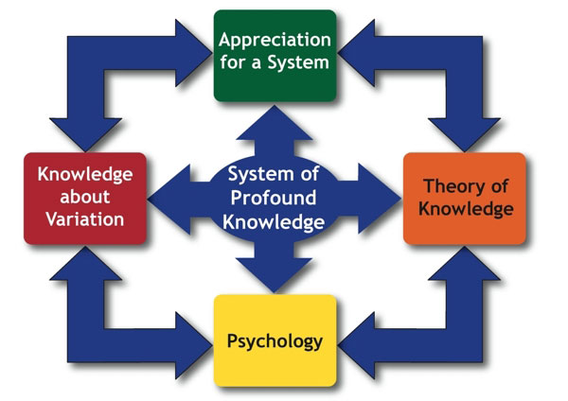
Quality: Philosophies
Theory of Profound Knowledge
The System of Profound Knowledge provides a foundation for continual improvement.

Slide 56
Quality: Philosophies
Theory of Profound Knowledge
The System of Profound Knowledge provides a foundation for continual improvement.
I. Appreciation for a system: system optimization need coordination and cooperation so Understanding becomes crucial
II. Knowledge about Variation: certain aspects of variation we want to make in our products
III. Theory of Knowledge: Knowledge depends on theory. Information is not knowledge. Practice makes permanent, not perfect. Copying examples does not lead to knowledge.
IV. Knowledge of Psychology: Leaders must understand human behavior to motivate, coordinate and manage people to optimize the system.

Slide 57
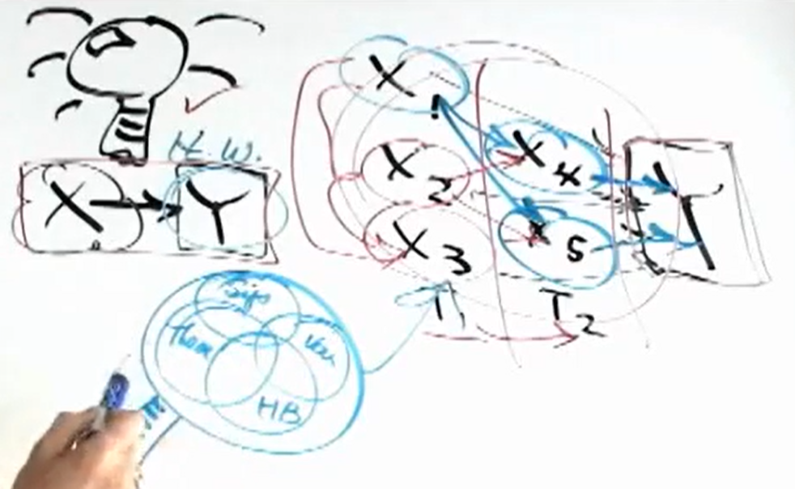
Quality: Philosophies
Theory of Profound Knowledge
Example: Want to change process of handwashing
https://i.imgur.com/jo1O7Sm.png

Slide 58
Principles of Quality: Dr. W. Edwards Deming
Create a Constant Purpose Toward Improvement: long term vision for making products for long durability
Adopt the New Philosophy: mobile phone competitors
Stop Depending on Inspections: inspect whole manufacturing process rather product
Use a Single Supplier for Any One Item: Quality relies on consistency – the less variation you have in the input, the less variation you'll have in the output
Improve Constantly and Forever: improve product quality
Use Training on the Job: train your employees to stay in competition
Implement Leadership: supervisor should be good enough to lead

Slide 59
Principles of Quality: Dr. W. Edwards Deming
Eliminate Fear: ensuring that they're not afraid to express ideas, don’t blame anyone
Break Down Barriers Between Departments: Build a shared vision.
Minimize the total cost: of product from raw material to operational cost
Get Rid of Unclear Slogans: don’t give target to employee, employee focus on number not quality
Remove Barriers to Pride of Workmanship: one group get prize others get depression
Implement Education and Self-Improvement: Improve the current skills of workers.
Make "Transformation" Everyone's Job: execute the plan

Slide 60
Quality: Philosophies
Juran
His quality management approach is based on three key principles: the Pareto principle; quality management principles; and the Juran Trilogy – quality planning, quality control, and quality improvement.
The Juran Trilogy is an improvement cycle that is meant to reduce the cost of poor quality by planning quality into the product / process.

Slide 61
Juran’s Triology
Quality Planning (Quality by Design)
Quality Control (Process Control & Regulatory)
Quality Improvement (Lean Six Sigma)

Slide 62
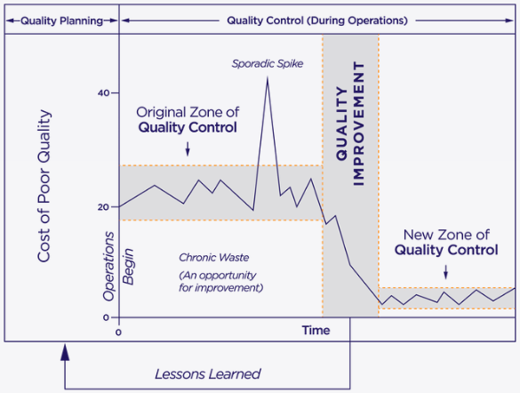
Juran’s Triology

Slide 63
Juran’s 10 step process
Build awareness : of need and opportunity for improvement.
Set goals for improvement.
Organize to reach the goals.
Provide training.
Carry out projects to solve problems.
Report progress.
Give recognition.
Communicate results.
Keep score
Maintain momentum by making annual improvement part of the regular processes

Slide 64
Quality: Philosophies
Feigenbaum
Armand V. Feigenbaum is known for his work on total quality control, and quality costs. He is the originator of the concept of the “hidden plant,” the assertion that a proportion of the capacity of every factory is wasted due to not getting things right first time.
Shewhart
Walter A Shewhart honed his skills while working at Bell Telephone, where his work focused on reducing variation in a manufacturing process. He was recognized as the originator of statistical quality control (SQC) and also created the “Shewhart cycle”, or “Plan-Do-Check-Act” (PDCA).
Notes:
Feigenbaum

Slide 65
Quality: Philosophies
Shingo
Shigeo Shingo was a frontrunner in continuous process improvement and operational excellence. He developed the concept of the Single-Minute Exchange of Die (SMED), aimed at cutting waste in manufacturing processes.
Crosby
Philip Crosby found fame on publication of his book Quality is Free, in 1979. In addition to that, he is known for the principle of “doing it right the first time” (DIRFT) and the Four Absolutes of Quality.

Slide 66
Quality: Philosophies
Taguchi
Genichi Taguchi’s methodology pushes the concepts of quality and reliability back to the design stage. It constitutes an efficient technique for designing product tests prior to the commencement of manufacturing, so ensuring quality, not defect, is designed in.
Ishikawa
Kaoru Ishikawa introduced the concept of quality circles and was a fervent believer in the need for quality to be company-wide. He is arguably best-known for the Ishikawa Diagram – also known as the fishbone or cause and effect diagram – used to identify the root cause of an event and commonly employed in quality defect prevention initiatives.

Slide 67
Principles of Quality: Dr. W. Edwards Deming
Create a Constant Purpose Toward Improvement
Adopt the New Philosophy
Stop Depending on Inspections
Use a Single Supplier for Any One Item
Improve Constantly and Forever
Use Training on the Job
Implement Leadership
Eliminate Fear
Break Down Barriers Between Departments
Get Rid of Unclear Slogans
Eliminate Management by Objectives
Remove Barriers to Pride of Workmanship
Implement Education and Self-Improvement
Make "Transformation" Everyone's Job

Slide 68
Summary
Quality: Philosophies
Juran’s Triology
Principles of Quality (Deming)

Slide 69
Daily Quiz
Q1. Describe the Juran’s triology.
Q2. Elaborate of the philosophies of quality and it’s advent in business.
Q3. Describe 14 principles of quality propounded by Deming.
Q4. Opine yourself on quality in product development and process.
Q5. Define the quality.

Slide 70
Noida Institute of Engineering and Technology, Greater Noida
(Unit –IV) Topic 3
Customer perception on quality
Kaizen & 6 Sigma

Slide 71
Topic & CO Mapping
Topic | CO | Level
Customer perception on quality, Kaizen, 6 Sigma | CO 4 | 2

Slide 72
Topic Objectives And Outcomes
Topic Objectives:
To understand the concept of quality from customer’s perspective
To learn about quality management tools
Topic Outcomes:
Ability to deliver quality in offerings
Ability to apply quality management tools.

Slide 73
Recap
Quality: Philosophies
Juran’s Triology
Principles of Quality (Deming)

Slide 74
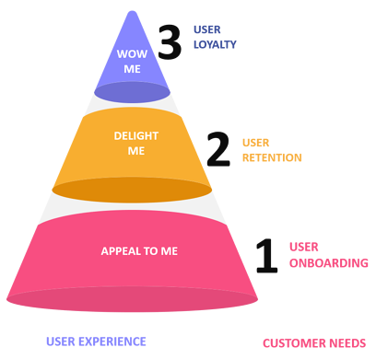
Quality: Customer Perspective

Slide 75
Quality: Customer Perspective
Performance - operating characteristics (speed, comfort, ease of use, and so on); for multiple performance features, the relative importance of each
Features - extras, add-ons, or gimmicks that enable a customer to somewhat customize a product
Reliability - the likelihood that the product will perform as expected and not malfunction within a given time period
Conformance - the degree to which the product satisfies or conforms to pre-established standards

Slide 76
Quality: Customer Perspective
Durability - the length of time, or extent of use, before the product deteriorates and must be replaced; durability is a function of the product's operating environment and reliability
Serviceability - the speed, ease, and convenience of getting or making maintenance work or repairs and the courtesy and competency of service people
Aesthetic - the look, sound, smell, feel, or taste of the product based on personal taste; though subjective, some aesthetic judgments tend to be common
Perceived Value - subjective opinions about the product based on images or attitudes formed by advertising and/or the reputation of the producer

Slide 77
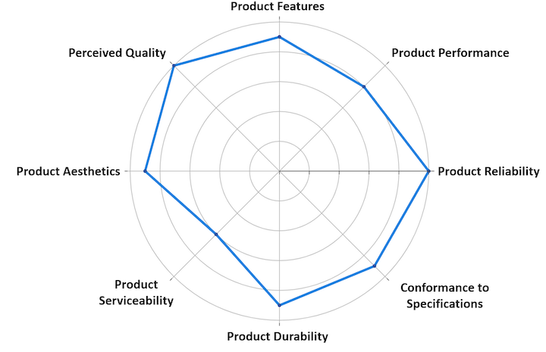
Eight Dimensions of Quality

Slide 78
KAIZEN
Masaaki Imai sat down to pen the groundbreaking book
‘Kaizen: The Key to Japan’s Competitive Success’
Through this book, the term KAIZEN™ was introduced in the western world.
Today KAIZEN™ is recognized worldwide as an important pillar of an organization’s long-term competitive strategy. Since introducing this term as a systematic approach for business improvement, companies that implement KAIZEN™ have continually yielded superior results.

Slide 79
KAIZEN: Definition
"KAIZEN™ means improvement. Moreover, it means continuing improvement in personal life, home life, social life, and working life. When applied to the workplace KAIZEN™ means continuing improvement involving everyone – managers and workers alike."
Masaaki Imai, Founder of Kaizen Institute

Slide 80
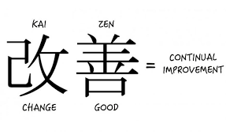
KAIZEN

Slide 81
Kaizen: 5 Principles
Know your Customer
Let it Flow
Go to Gemba
Empower People
Be Transparent.

Slide 82
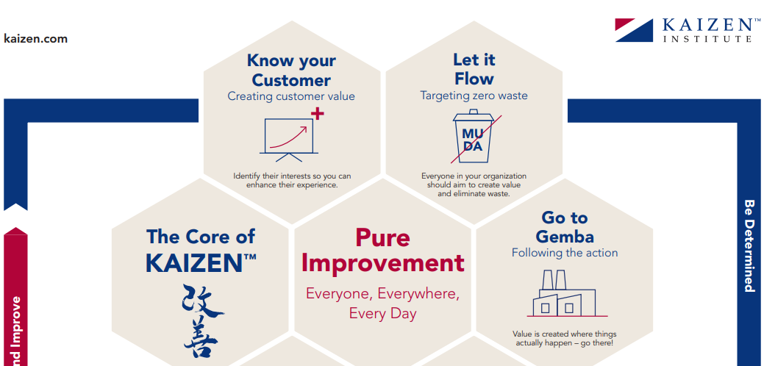


Slide 83
Six Sigma: Introduction
Six Sigma is a methodology used to improve business processes by utilizing statistical analysis rather than guesswork.
Processes are improved by controlling variation and understanding the intricacies within them.

Slide 84
Six Sigma: Introduction
Six Sigma (6σ) is a set of techniques and tools for process improvement. It was introduced by American engineer Bill Smith while working at Motorola in 1986.
Six Sigma strategies seek to improve manufacturing quality by identifying and removing the causes of defects and minimizing variability in manufacturing and business processes.

Slide 85
Six Sigma Philosophy
The Six Sigma methodology is defined by five DMAIC steps and a preceding “step zero” known as Six Sigma Leadership.
DMAIC is the acronym for:
Define – What is important?
Measure – How are we doing?
Analyze – What is wrong?
Improve – What needs to be done?
Control – How do we guarantee performance?

Slide 86
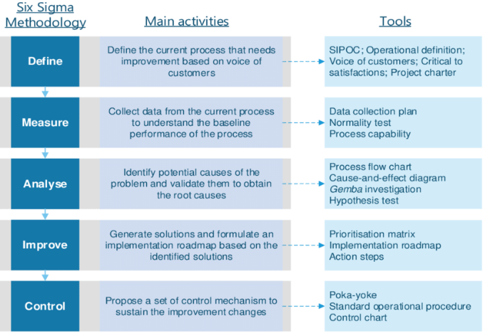
DMAIC framework and Six-Sigma tools

Slide 87
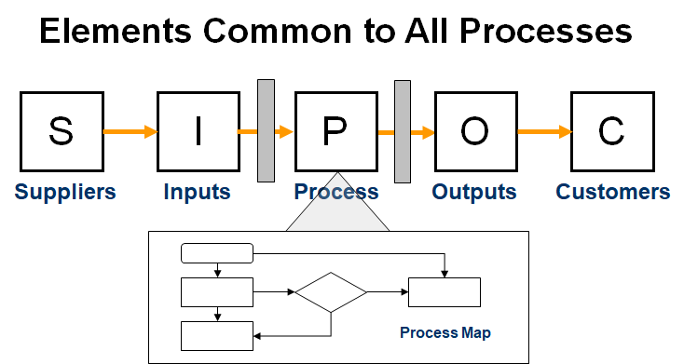
SIPOC

Slide 88
SIPOC
Suppliers – Suppliers supply the inputs for the process.
Inputs – Materials, equipment, information, forms, staff, etc.
Process – The steps of the process your team is improving, from the initial step to the final step/delivery of the product or service.
Outputs – The product or service that is delivered to the internal or external customers as an output of the process, i.e. reports, products, services, etc.
Customers – Anyone who receives the outputs.

Slide 89
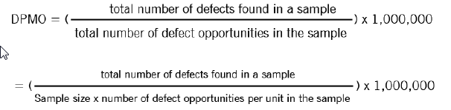
Defects Per Million Opportunities (DPMO)
This represents a ratio of the number of defects in one million opportunities. In other words, how many times did you have a flaw or mistake (defect) for every opportunity there was to have a flaw or mistake.
The formula for calculating DPMO is as follows.

Slide 90
Defects Per Million Opportunities (DPMO)
Three Sigma quality – This level of performance produces a defect-free product 93.32% of the time.
Four Sigma quality – This level of performance yields a defect-free product 99.349% of the time.
Five Sigma quality – Five Sigma performance produces defect-free products and services 99.977% of the time.
Six Sigma quality – Six Sigma performance produces a defect-free product 99.99966% of the time; allowing only 3.4 errors per one million opportunities.

Slide 91
Summary
Customer’s perspective of Quality
KAIZEN
Six Sigma

Slide 92
Daily Quiz
Q1. Describe the concept of Six sigma
Q2. Discuss the concept of DPMO.
Q3. Describe the DMAIC process.
Q4. Explain the concept of SIPOC.

Slide 93
Noida Institute of Engineering and Technology, Greater Noida
(Unit –IV) Topic 4
Leadership, types, qualities and traits of leaders and leadership styles, Leaders vs Manager

Slide 94
Topic & CO Mapping
Topic | CO | Level
Leadership, qualities and traits of leaders and leadership styles, Leaders vs Manager | CO 4 | 3

Slide 95
Topic Objectives And Outcomes
Topic Objectives:
To understand the leadership theories and styles.
To learn the working aspects of leader and manager.
Topic Outcomes:
Ability to effectively lead people and teams leadership in organization

Slide 96
Recap
Customer’s perspective of Quality
KAIZEN
Six Sigma

Slide 97
Leadership
Leadership is the ability of an individual or a group of individuals to influence and guide followers or other members of an organization.
"Leadership is the art of getting someone else to do something you want done because he wants to do it.“
Former U.S. President Dwight D. Eisenhower

Slide 98
Traits & Qualities of Leaders
Vision
Inspiration
Strategic & Critical Thinking
Interpersonal Communication
Authenticity & Self-Awareness
Open-Mindedness & Creativity
Flexibility
Responsibility & Dependability
Patience & Tenacity
Continuous Improvement
Fostering Creativity And Innovation

Slide 99
Leadership: Styles
Autocratic, Authoritarian, Coercive, or Commanding:
Autocratic leaders make decisions without seeking input from anyone who reports to them, or anyone at all, usually. Team members are not consulted prior to direction and are expected to fall in line with the leader’s expectations.
Rarely effective and can lead to low job satisfaction and poor morale.
However, autocratic leadership can be effective in crisis situations when quick decisions need to be made.

Slide 100
Leadership: Styles
Bureaucratic:
Bureaucratic leaders tend to follow a textbook template as to how a leader should act, and are generally risk averse.
Typically found in large, established organizations or highly regulated environments where adherence to strict rules is important.
This leadership style stifles innovation among employees and struggles to respond effectively to change.

Slide 101
Leadership: Styles
Affiliative:
Affiliative leaders strive to create emotional bonds with their team members and direct reports.
This style is focused on building trust within the team and fostering a sense of belonging to the organization.
Particularly effective during times of heightened stress
Constant praise and nurturing can cause performance issues to be overlooked and unaddressed.

Slide 102
Leadership: Styles
Democratic, Facilitative, or Participative:
Places a high value on the knowledge, skills, and diversity of their team.
They are consensus-builders and are constantly asking for input from their direct reports and peers.
Democratic leaders are excellent listeners, and they develop confidence in their leadership by utilizing the collective wisdom their team has to offer.

Slide 103
Leadership: Styles
Laissez-Faire or Delegative
The French term "laissez faire" translated to English is "let them do." In other words, a laissez-faire leader trusts their employees to do what they’re supposed to do and offers minimal interference – and direction.
The laissez-faire leader is most commonly found in entrepreneurial start-ups, where the founder puts full trust in their team so they may focus on executing the company’s overall strategy.

Slide 104
Leadership: Styles
Transactional:
Transactional leaders are only concerned with the work their employees do.
Common among sales teams, a transactional leader will often set a sales target and reward the individuals who reach it with a bonus.

Slide 105
Leadership: Styles
Transformational:
Focused on continuous improvement.
Constantly push their team outside of their comfort zone and implement stretch goals.
This style is often associated with charismatic leadership, a leadership style rooted in the charm and persuasiveness of the leader.

Slide 106
Leaders vs Managers
Leaders create a vision, managers create goals.
Leaders are change agents, managers maintain the status quo.
Leaders are unique, managers copy.
Leaders take risks, managers control risk
Leaders are in it for the long haul, managers think short-term.
Leaders grow personally, managers rely on existing, proven skills.
Leaders build relationships, managers build systems and processes.
Leaders coach, managers direct.
Leaders create fans, managers have employees.

Slide 107
Summary
Leadership
Leadership traits and qualities
Leadership Styles
Leader vs Manager

Slide 108
Daily Quiz
Q1. Describe the autocratic leadership style.
Q2. Discuss the traits and qualities of effective leaders.
Q3. Describe the transactional leadership style.
Q3. Enumerate the differences between leaders and manager.
Q4. Explain the participative leadership style.
Q5. Describe the leadership.

Slide 109
Noida Institute of Engineering and Technology, Greater Noida
(Unit –IV) Topic 5
Personas of Leaders & Managers Connecting Leaders-Managers with 13 Musical Notes

Slide 110
Topic & CO Mapping
Topic | CO | Level
Personas of Leaders & Managers, Connecting Leaders-Managers with 13 Musical Notes | CO 4 | 2

Slide 111
Topic Objectives And Outcomes
Topic Objectives:
To understand the persona of a leader.
Creating connect between 13 musical notes and leadership.
Topic Outcomes:
Ability to create and analyze leader’s persona for effectively attaining the goals with teams.

Slide 112
Recap
Leadership
Leadership traits and qualities
Leadership Styles
Leader vs Manager

Slide 113
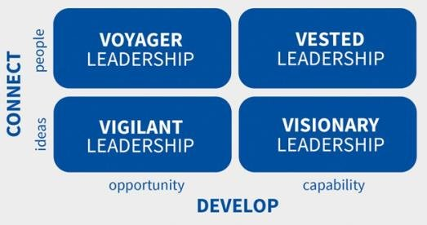
Persona of Leader

Slide 114
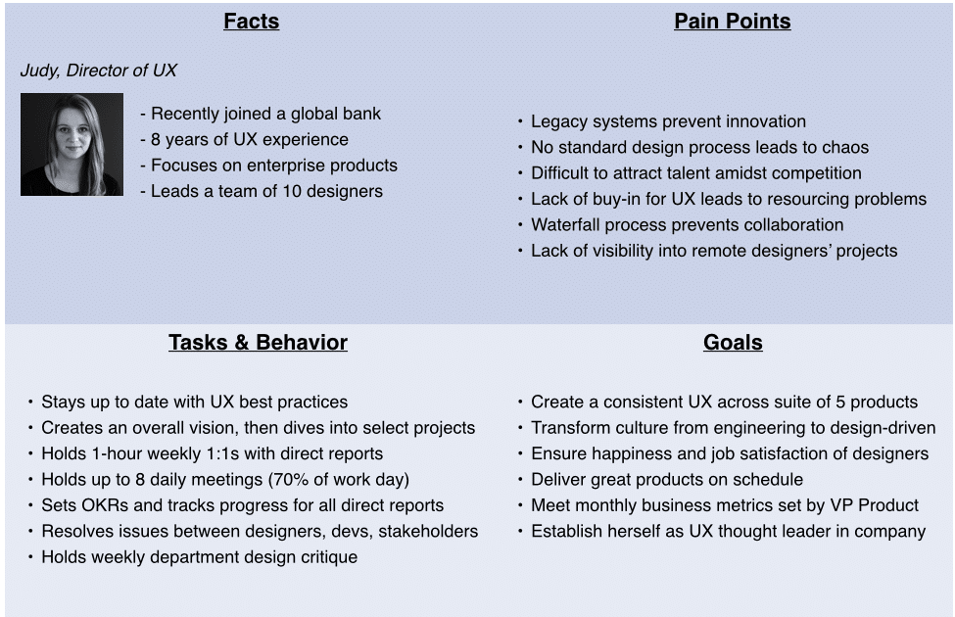
Persona of Leader

Slide 115



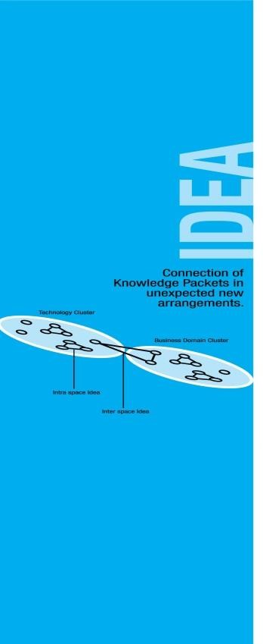
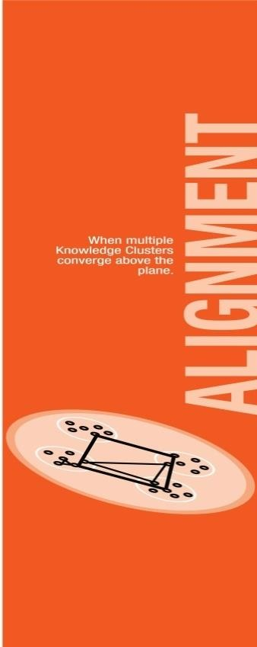
13 Musical Notes with Leadership: SEPIA

Slide 116
SEPIA: Leadership Connect
Developing the skills
Identifying expertise
Creating and analyzing perspective
Generating the idea
Aligning the thoughts

Slide 117
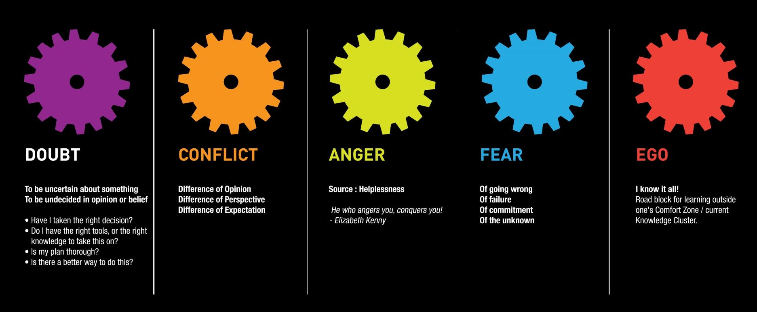

DCAFE: Five Frictional Forces

Slide 118
DCAFE: Leadership Connect
Eradicating doubts
Resolving the conflicts
Controlling the anger
Removing fear of failure
Handling Egos

Slide 119
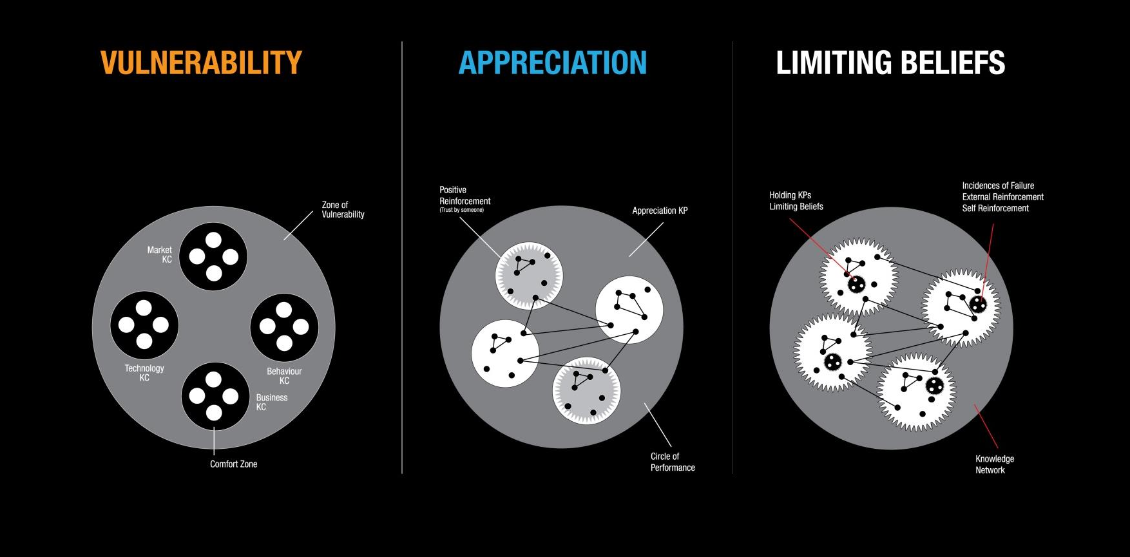
VAL: Capacity Levers

Slide 120
VAL: Leadership Connect
Identifying vulnerability and comfort zones
Appreciation of good and new
Eradicating limiting beliefs

Slide 121
Summary
Persona of Leader
Connecting 13 musical notes with leadership

Slide 122
Daily Quiz
Q1. Discuss the connection between VAL and leadership.
Q2. Explain the rationale behind the SEPIA with Leadership framework.
Q3. Describe the connect between 5 frictional forces and leadership.
Q4. Describe the persona of a leader.

Slide 123
Noida Institute of Engineering and Technology, Greater Noida
(Unit –IV) Topic 6
LSM (Leadership Situational Model)
Team Building Models: Tuckman's and Belbin's. Importance of Spatial elements for innovation

Slide 124
Topic & CO Mapping
Topic | CO | Level
LSM (Leadership Situational Model), Team Building Models: Tuckman's and Belbin's. Importance of Spatial elements for innovation | CO 4 | 3

Slide 125
Topic Objectives And Outcomes
Topic Objectives:
To understand leadership model
To understand the concept of team building.
Topic Outcomes:
Ability to effectively work with teams

Slide 126
Recap
Persona of Leader
Connecting 13 musical notes with leadership

Slide 127
Leadership Situational Model (LSM)
Based on the relationship between leaders and followers and provides a framework to analyze each situation based on the Performance Readiness Level that a follower exhibits in performing a specific task, function or objective.
Based on the leader’s diagnosis, the necessary amounts of relationship behavior and task behavior are applied and communicated to the follower in order to support their needs and advance development.

Slide 128
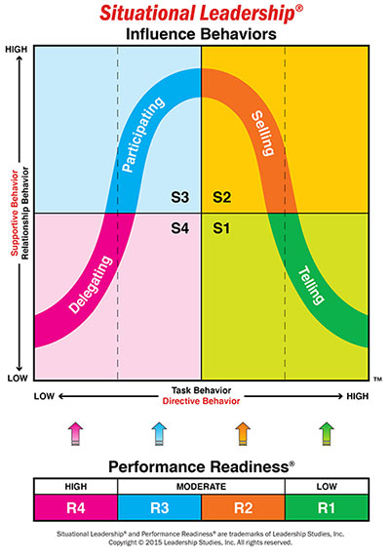
Leadership Situational Model (LSM)

Slide 129
Benefits of Situation Leadership
Creates a common language of performance
Accounts for multi-directional influence
Utilizes task specificity as a measure of performance versus typecasting employees
Allows leaders to effectively drive behavior change
Accelerates the pace and quality of employee development
Teaches leaders to accurately interpret and effectively respond to their environment

Slide 130
Team Building
A management technique used for improving the efficiency and performance of the workgroups through various activities.
Involves a lot of skills, analysis and observation for forming a strong and capable team.
The whole sole motive here is to achieve the organization vision and objectives.

Slide 131
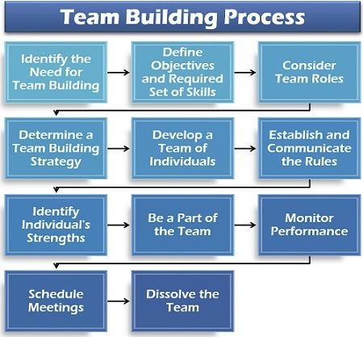
Team Building Process

Slide 132
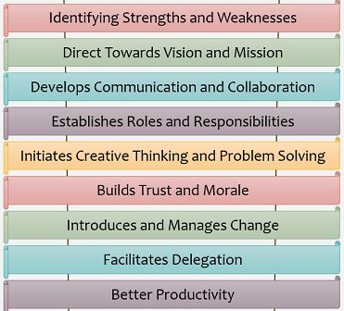
Advantages of Team Building

Slide 133
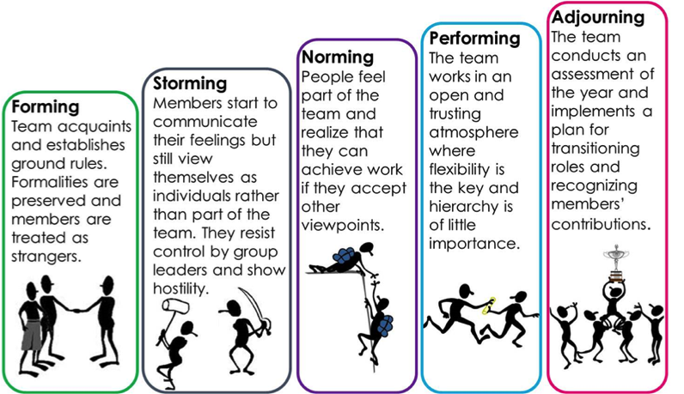
Tuckman’s Model of Teambuilding

Slide 134
Belbin’s Model: Team Roles
Dr Meredith Belbin defines a 'Team Role' as one of nine clusters of behavioural attributes identified by his research at Henley as being effective in order to facilitate team progress.

Slide 135
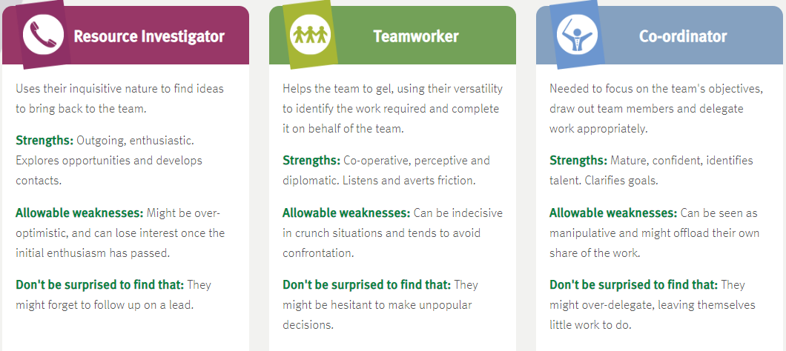
Belbin’s Model: Team Roles

Slide 136
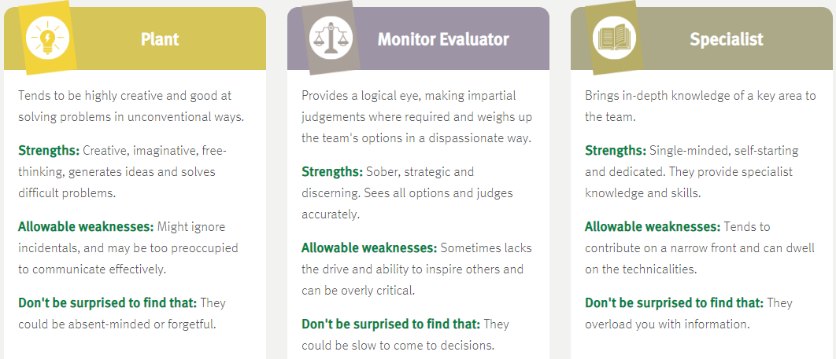
Belbin’s Model: Team Roles

Slide 137
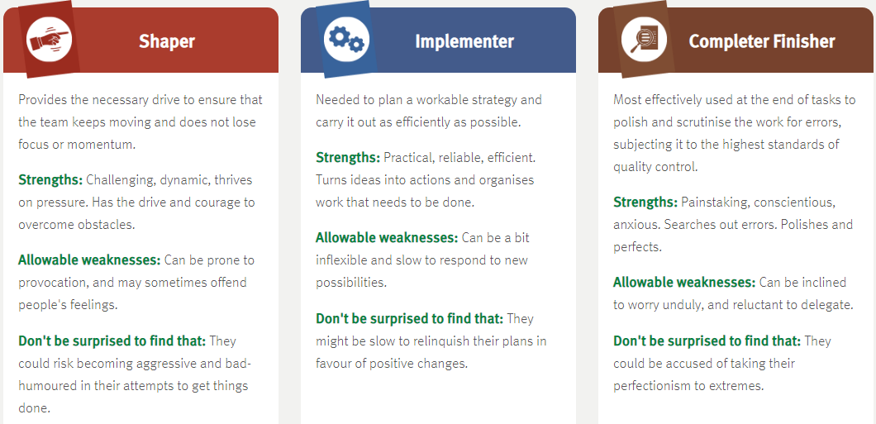
Belbin’s Model: Team Roles

Slide 138
Spatial Elements for Innovation
The Key Elements of Innovation:
Collaboration
Ideation
Implementation and
Value Creation
Innovation requires collaboration, ideation, implementation and value creation.

Slide 139
Summary
Tuckman’s Team development model
Belbin’s nine team roles
Spatial Innovation

Slide 140
Youtube Links
https://www.youtube.com/watch?v=MjSOjwixR4k
https://www.youtube.com/watch?v=eFzp0zn9Wno
https://www.youtube.com/watch?v=keCwRdbwNQY

Slide 141
Weekly Assignment
Q1. Discuss the need and importance of innovation.
Q2. Enumerate various leadership styles.
Q3. Describe the concept of Six Sigma in quality.
Q4. . Differentiate between leader and manager.
Describe the Bruce Tuckman’s model of team development.

Slide 142
Topic Links / References / Video Links
https://www.kaizen.com/what-is-kaizen#core_kaizen
https://www.belbin.com/about/belbin-team-roles

Slide 143
MCQ s
Q1. Regarding leadership, which statement is false?
Leadership does not necessarily take place within a hierarchical structure of an organisation
When people operate as leaders their role is always clearly established and defined
Not every leader is a manager
All of the above
Q2. Innovation is defined as:
a) the commercialization of a new product or process.
b) the invention of a new product or process.
c) a new product or process idea.
d) the implementation of a new production method.

Slide 144
MCQ s
Q3. Innovation can help to provide a temporary competitive advantage when:
a) barriers to entry are high.
b) barriers to imitation are low and intellectual property rights are difficult to enforce.
c) there are few other competitors.
d) barriers to entry are low.
Q4. Innovation can help to provide a temporary competitive advantage when:
a) barriers to entry are high.
b) barriers to imitation are low and intellectual property rights are difficult to enforce.
c) there are few other competitors.
d) barriers to entry are low.

Slide 145
MCQ s
Q5. Innovation can help to provide a temporary competitive advantage when:
a) barriers to entry are high.
b) barriers to imitation are low and intellectual property rights are difficult to enforce.
c) there are few other competitors.
d) barriers to entry are low.
Q6. Innovation can help to provide a temporary competitive advantage when:
a) barriers to entry are high.
b) barriers to imitation are low and intellectual property rights are difficult to enforce.
c) there are few other competitors.
d) barriers to entry are low.

Slide 146
Glossary Questions
Q. 1. Attempt all the parts: please pick the correct option from Glossary
(i) Incremental innovation
(ii) quality circles
(iii) KAIZEN
(iv) VAL
a. …………represents the capacity levers.
b. …………….means improvement.
c. Kaoru Ishikawa introduced the concept of……….
d. Small changes that increase the efficiency of current business model relates to……………

Slide 147
Glossary Questions
Q. 2. Attempt all the parts: please pick the correct option from Glossary
(i) Innovation
(ii) Belbin
(iii) Tuckman
(iv) DPMO
a. Ratio of the number of defects in one million opportunities is………
b. …………….is Turning a new concept into commercial success or widespread use.
c. Nine roles in teambuilding are suggested by ……..
d. ……………suggested team development model.

Slide 148
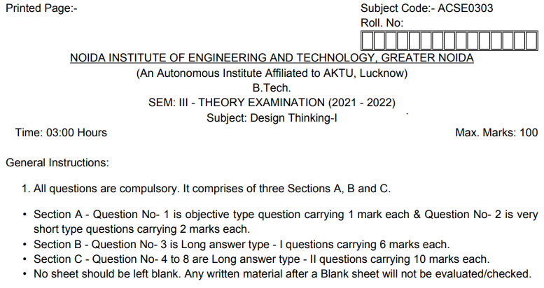
Old Question Papers

Slide 149
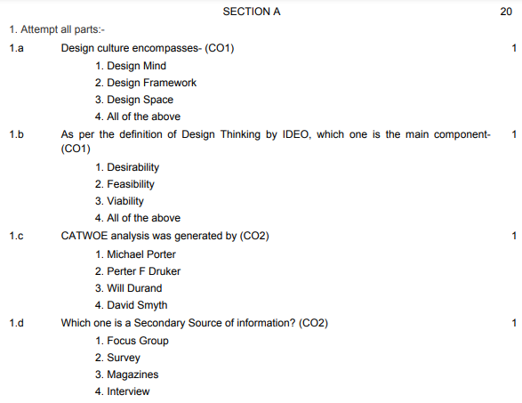
Old Question Papers

Slide 150
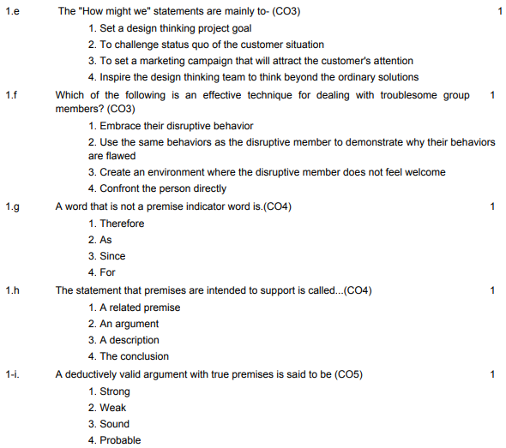
Old Question Papers

Slide 151
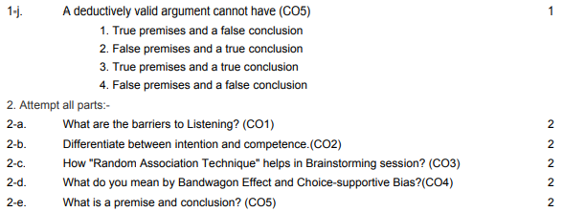
Old Question Papers

Slide 152
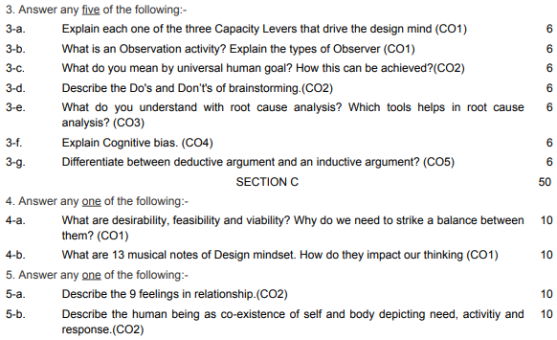
Old Question Papers

Slide 153
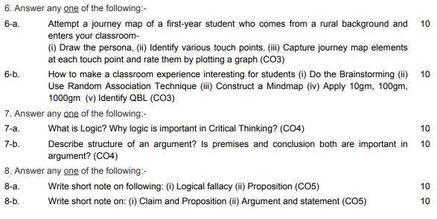
Old Question Papers

Slide 154
Expected Questions for University Exam
Q1. Discuss the situational leadership.
Q2. Describe the concept of quality with DMAIC.
Q3. Discuss the need and importance of innovation.
Q4. Enumerate various leadership styles
Q5. Describe the Bruce Tuckman’s model of team development.
Q6. Describe the Belbin’s model of team roles.
Q7. Describe the concept of Six Sigma in quality.
Q8. Connect the Leader and manager with 13 musical notes.
Q9. Describe the concept of SIPOC.
Q10. Differentiate between leader and manager.

Slide 155
Recap of Unit
Innovation
Quality
Leadership
Connecting Leaders-Managers with 13 Musical Notes
Importance of Spatial elements for innovation

Slide 156
Thank You

